Slide 1
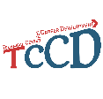



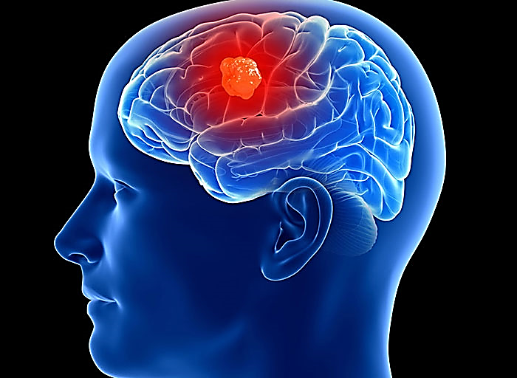
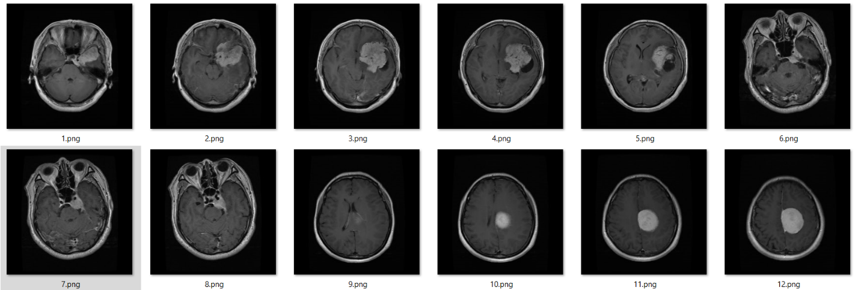
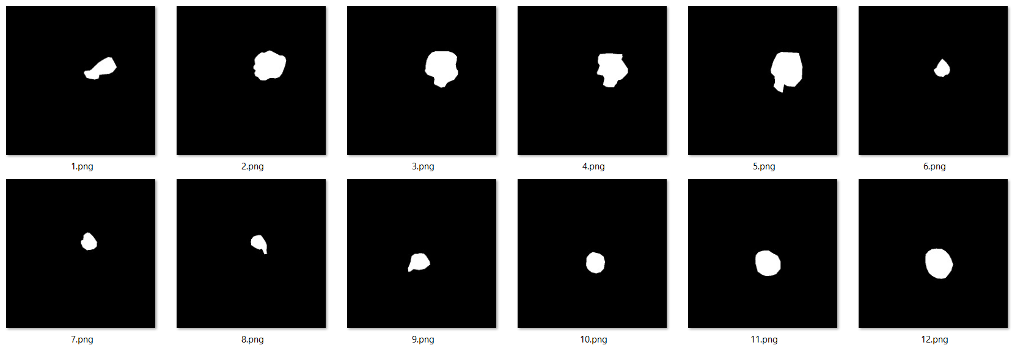
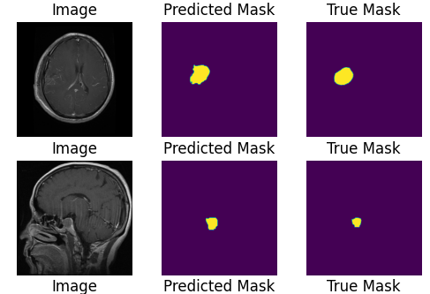
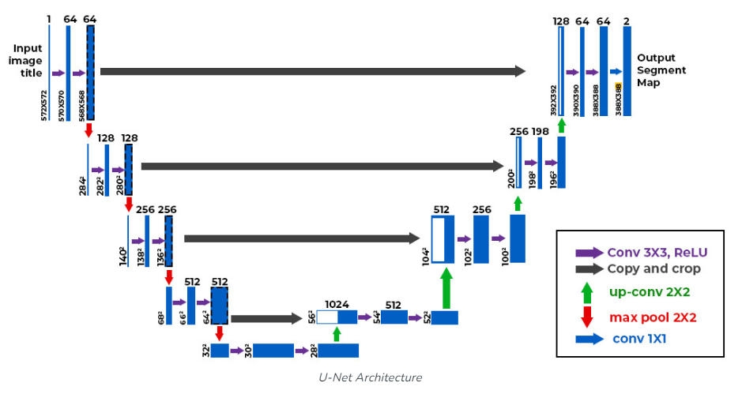
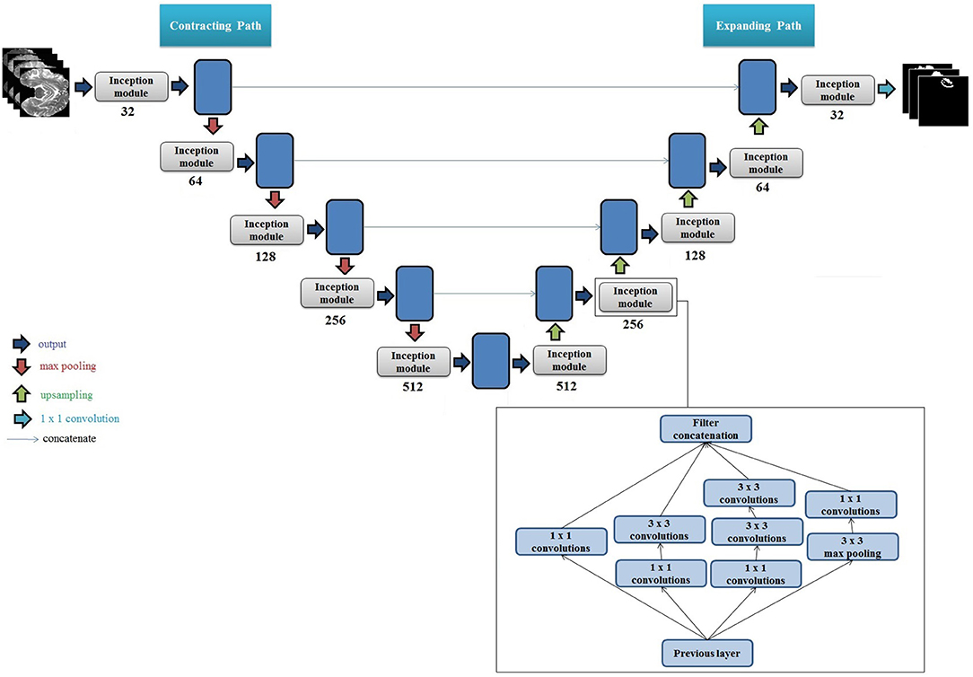
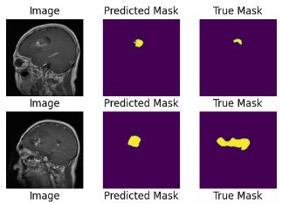
Math Magicians
Segmentation of brain tumour images using deep learning
Abstraction
The human brain is susceptible to tumor development when cell division goes awry, forming abnormal clusters within or around the brain. These tumors, generically termed brain tumors, arise from uncontrolled cellular growth and can vary in severity.
Dataset Description
Methodological Steps
The dataset consiste of two distinct folders (images and masks), each containing 3064 PNG images. The images are grayscale and possess dimensions of 512x512 pixels, portraying MRI scans of the brain.
Data Preprocessing
Model
Implementation
and
Compilation
Training Procedure
Model
Evaluation
Figure 1 Brain tumor
Model Evaluation
Introduction
Figure 2 MRI Images
Brain tumor segmentation plays a critical role in medical imaging for accurate diagnosis and treatment planning .The objective of this project is to perform brain tumor segmentation on MRI images using different deep learning architectures. like :
98.29%
98.19%
98.19%
U-NET
U-NET Inception
Inception U-Net
Inception U-Net
U-Net
Literature Review
Loss:
Dice Coefficient:
Loss:
Dice Coefficient:
Loss:
Dice Coefficient:
Figure 3 Masks
Inception Modules Enhance Brain Tumor Segmentation:
Methodology
U-Net with Intra-Tumoral Structures.
U-Net with Glioma Sub-Regions
U-Net with Inception Modules and Intra-Tumoral Structures Objective
U-Net with Inception Modules and Glioma Sub-Regions Objective
U-NET
Sample Of Predicted and Actual Masks
U-NET Inception
Figure 8 U-Net
Figure 8 Sample Of Predicted and Actual Masks For Inception U-Net
Advanced Level Foundation
Extended Foundation
Advanced Level Foundation
IELTS 5.0
Advanced Level Foundation
Figure 8 Inception U-Net
Figure 8 Sample Of Predicted and Actual Masks For U-Net
Sondos Mahmoud Manar Ashraf Noura Osama lamees Lama Zkaria

